Slide 1
Social Media Sentimental analysis using Azure Logic Apps and Cognitive Services
MADE BY: Dhruv Kinger(17bcs1785)
Akash Yadav(17bcs1817)

Slide 2
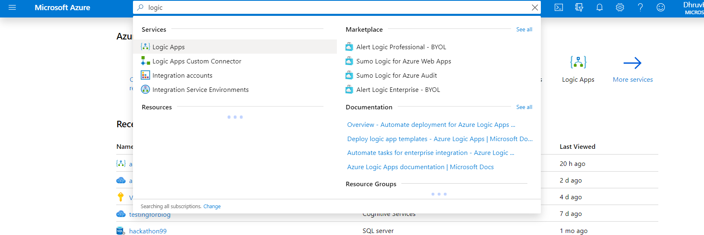
Screenshots of Project:
Azure Portal

Slide 3
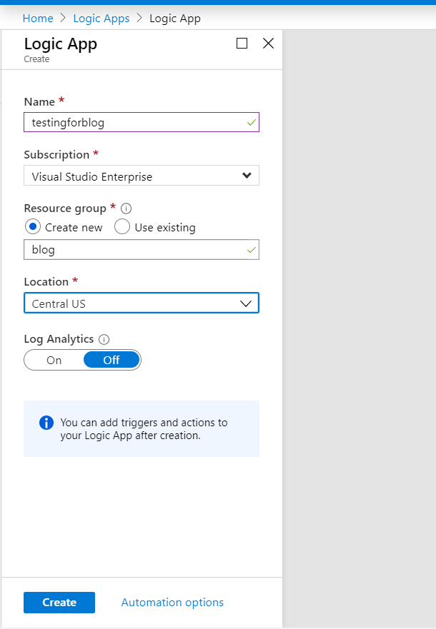
Creating Resource

Slide 4
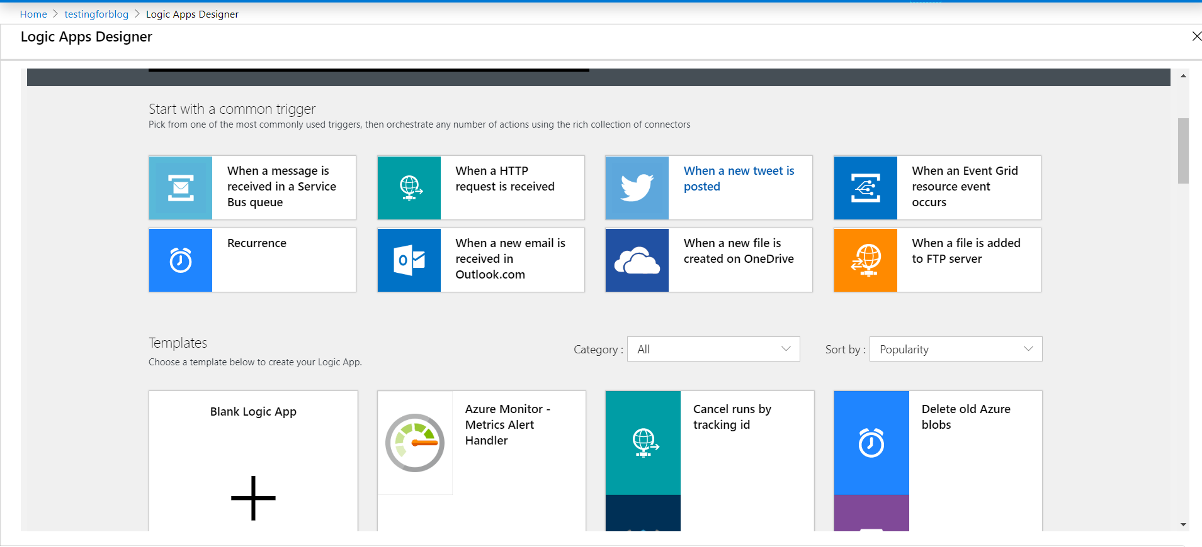
Logic Apps Designer

Slide 5
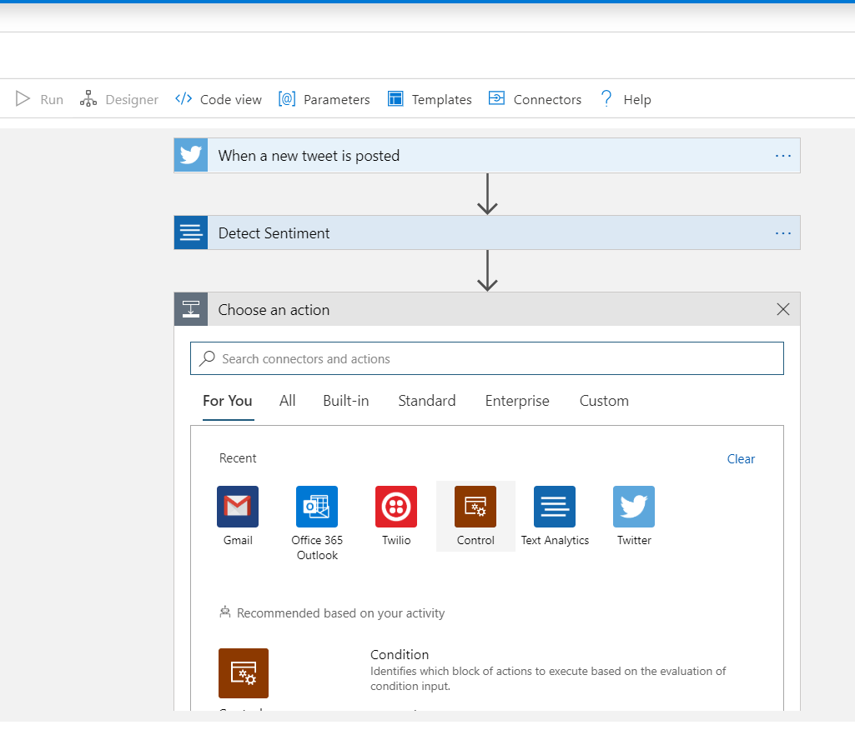
Logic Creation

Slide 6
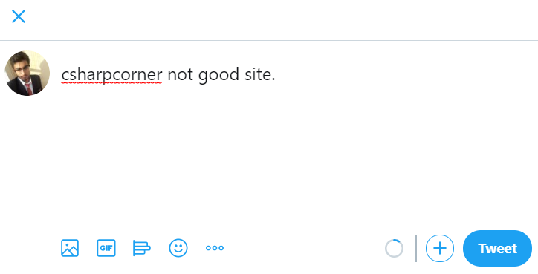
Tweeted Text

Slide 7
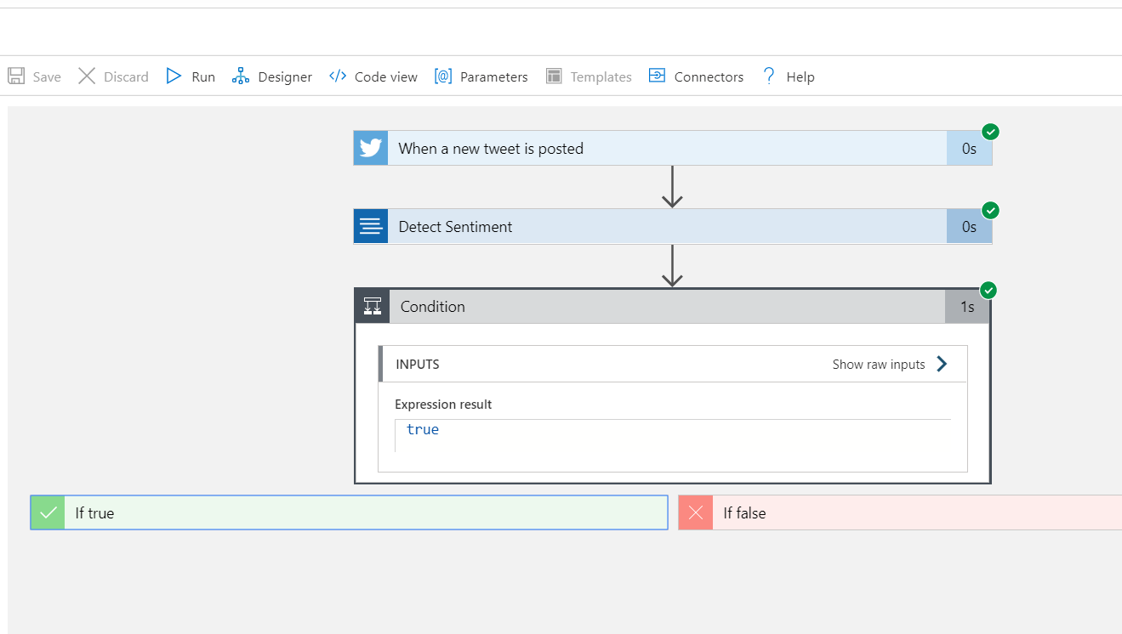
Final Logic Settings

Slide 8
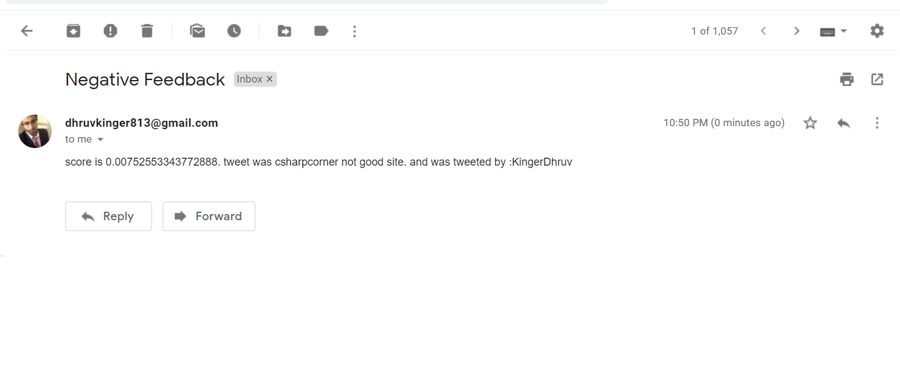
Result Obtained

Slide 9
THANKS

